Slide 1

Independent Publisher
Sessionize connector
Nanddeep Nachan (@NanddeepNachan)
Smita Nachan (@SmitaNachan)
09 June, 2022

Slide 2
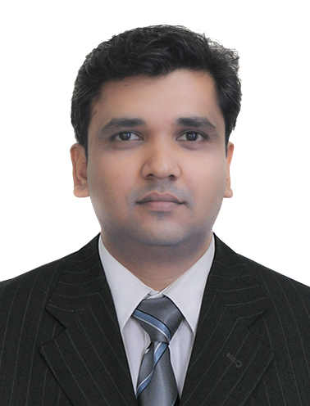





Authors
Nanddeep Nachan
@NanddeepNachan
/in/NanddeepNachan
NanddeepNachan@gmail.com
Smita Nachan
@SmitaNachan
/in/SmitaNachan
Smita.Nachan@gmail.com

Slide 3
Sessionize
Sessionize is the smart way to manage Call for Papers, Speakers and Agenda for your conference.
https://docs.microsoft.com/en-us/connectors/sessionizeip/
Driving Factor
Share the conference agenda by email
App for conference speakers

Slide 4
Demo
Using Sessionize Connector with Power Automate and Power Apps

Slide 5

THANK YOU
Nanddeep Nachan
Smita Nachan
@NanddeepNachan
@SmitaNachan
/in/NanddeepNachan
/in/SmitaNachan
NanddeepNachan@gmail.com
Smita.Nachan@gmail.com
https://nanddeepnachanblogs.com

